Slide 1
Working together to sustain social change
Tessa Boyd-Caine, CEO
Connection: The Force for Change
NTCOSS Conference 2023
Mparntwe (Alice Springs), 4 May 2023

Slide 2
Health Justice Australia
A national charity and the centre of excellence for health justice partnership.
This collaborative approach between health, legal assistance and other services works for better health and justice outcomes for people who are held in disadvantage.
Health Justice Australia supports the expansion and effectiveness of health justice partnerships through:
Knowledge and its translation: developing evidence and translating that evidence into knowledge that is valued by practitioners, researchers, policy-makers and funders
Building capability: supporting practitioners to work collaboratively, including through brokering, mentoring and facilitating partnerships
Driving systems change: connecting the experience of people coming through health justice partnerships, and their practitioners, with opportunities for lasting systems change through reforms to policy settings, service design and funding
Notes:
There are one, two and three column text page layouts – to switch between them, go to the home tab > click layout
2

Slide 3
Growth of health justice partnership in Australia

Slide 4
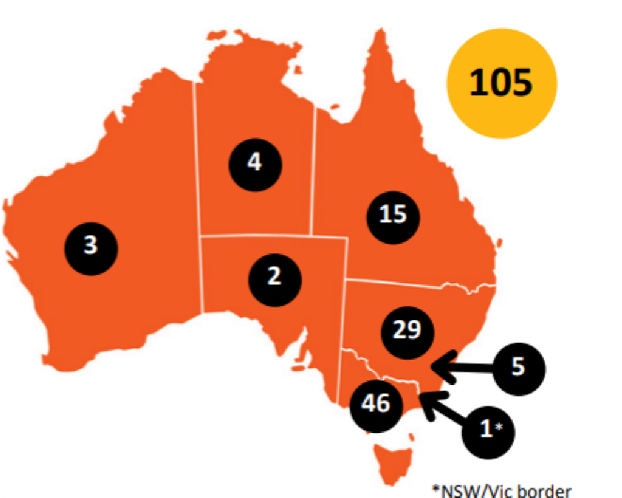
Health justice partnership across Australia
Notes:
4

Slide 5
Join at slido.com #3667863
ⓘ Start presenting to display the joining instructions on this slide.

Slide 6
In what ways do you currently work with or support people experiencing domestic and family violence?
ⓘ Start presenting to display the poll results on this slide.

Slide 7
Contact us
Health Justice Australia is the national centre for health justice partnerships, supporting collaborations between services to achieve better health and justice outcomes for vulnerable communities.
Dr Tessa Boyd-Caine, CEO
Tessa.Boyd-Caine@healthjustice.org.au
@tboydcaine

