Slide 1
Building
long-term strength
2017 NFP Governance and Performance Study
2017 NFP GOVERNANCE AND PERFORMANCE STUDY SPONSOR

Slide 2
2017 NFP GOVERNANCE AND PERFORMANCE STUDY
Key findings
Culture – front of mind but low on the agenda
Financial sustainability – many NFPs still reporting thin or negative profit margins
Risk management – sophistication varies greatly across the sector
Reputation – an invaluable asset but may be being taken for granted

Slide 3
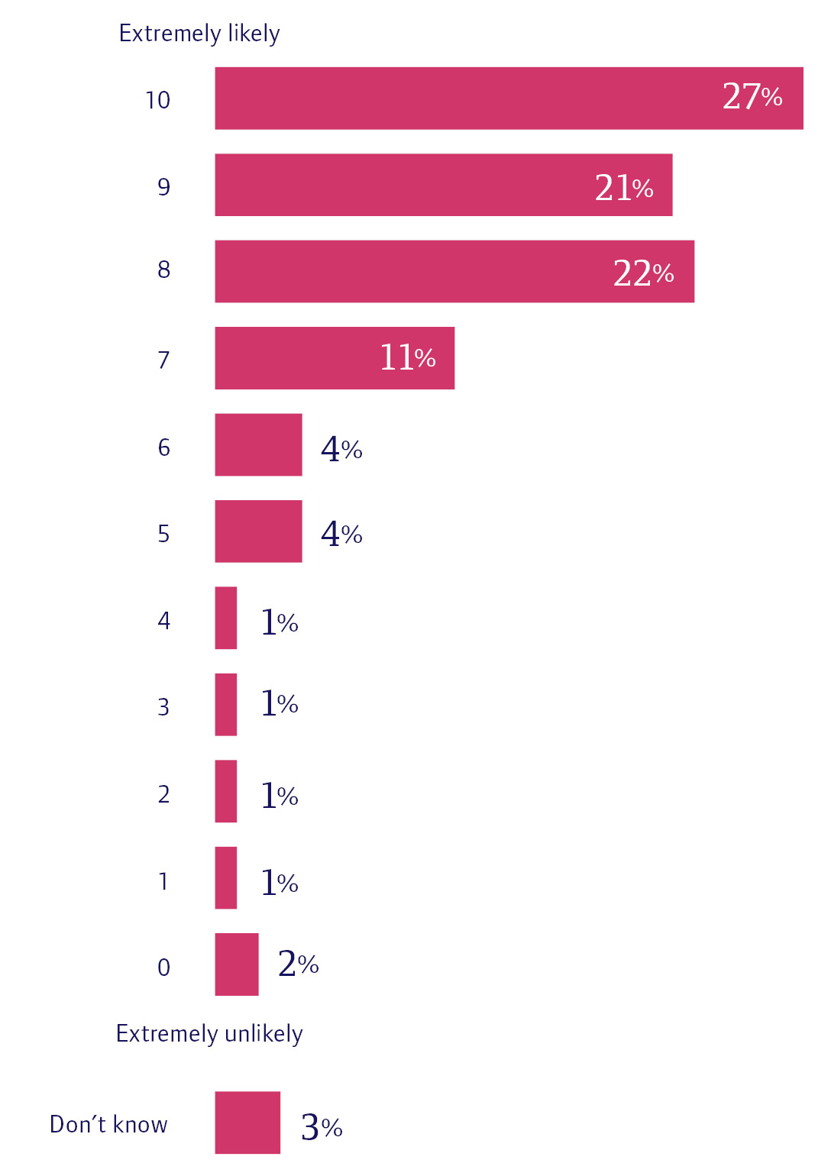
2017 NFP GOVERNANCE AND PERFORMANCE STUDY
Culture: front of mind, but bottom of agenda
Figure 1:
Most directors believe their organisations have strong cultures
More than 70% would be very likely to recommend their NFP as a place to work

Slide 4
2017 NFP GOVERNANCE AND PERFORMANCE STUDY
Culture: front of mind, but bottom of agenda
Only 45% said culture was clearly defined and embedded in processes
55% said culture is not being managed well

Slide 5
2017 NFP GOVERNANCE AND PERFORMANCE STUDY
Culture: front of mind, but bottom of agenda
But…
It is not on the board agenda
More than half said it had not been an agenda item at a board meeting in the last 12 months
Figure 3:

Slide 6
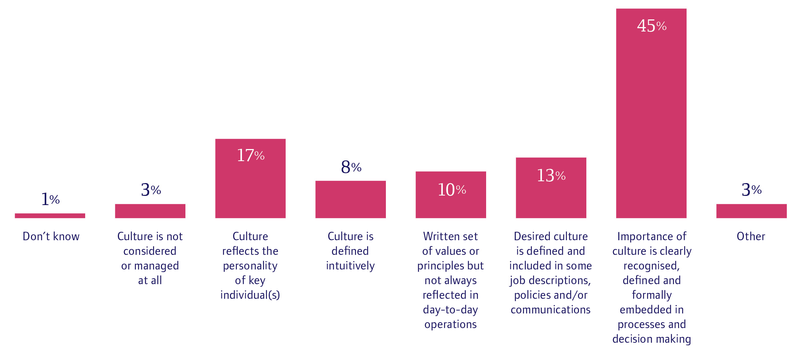
2017 NFP GOVERNANCE AND PERFORMANCE STUDY
Culture: front of mind, but bottom of agenda
Many organisations take only an informal approach to managing culture
Figure 2:

Slide 7
2017 NFP GOVERNANCE AND PERFORMANCE STUDY
Achieving financial sustainability
The 2016 study found that profit margins were slim at many NFPs and there was some misunderstanding around profit
2017 study shows that there is still work to be done to achieve financial sustainability across the sector
50% of directors reported slim or negative profit margins

Slide 8
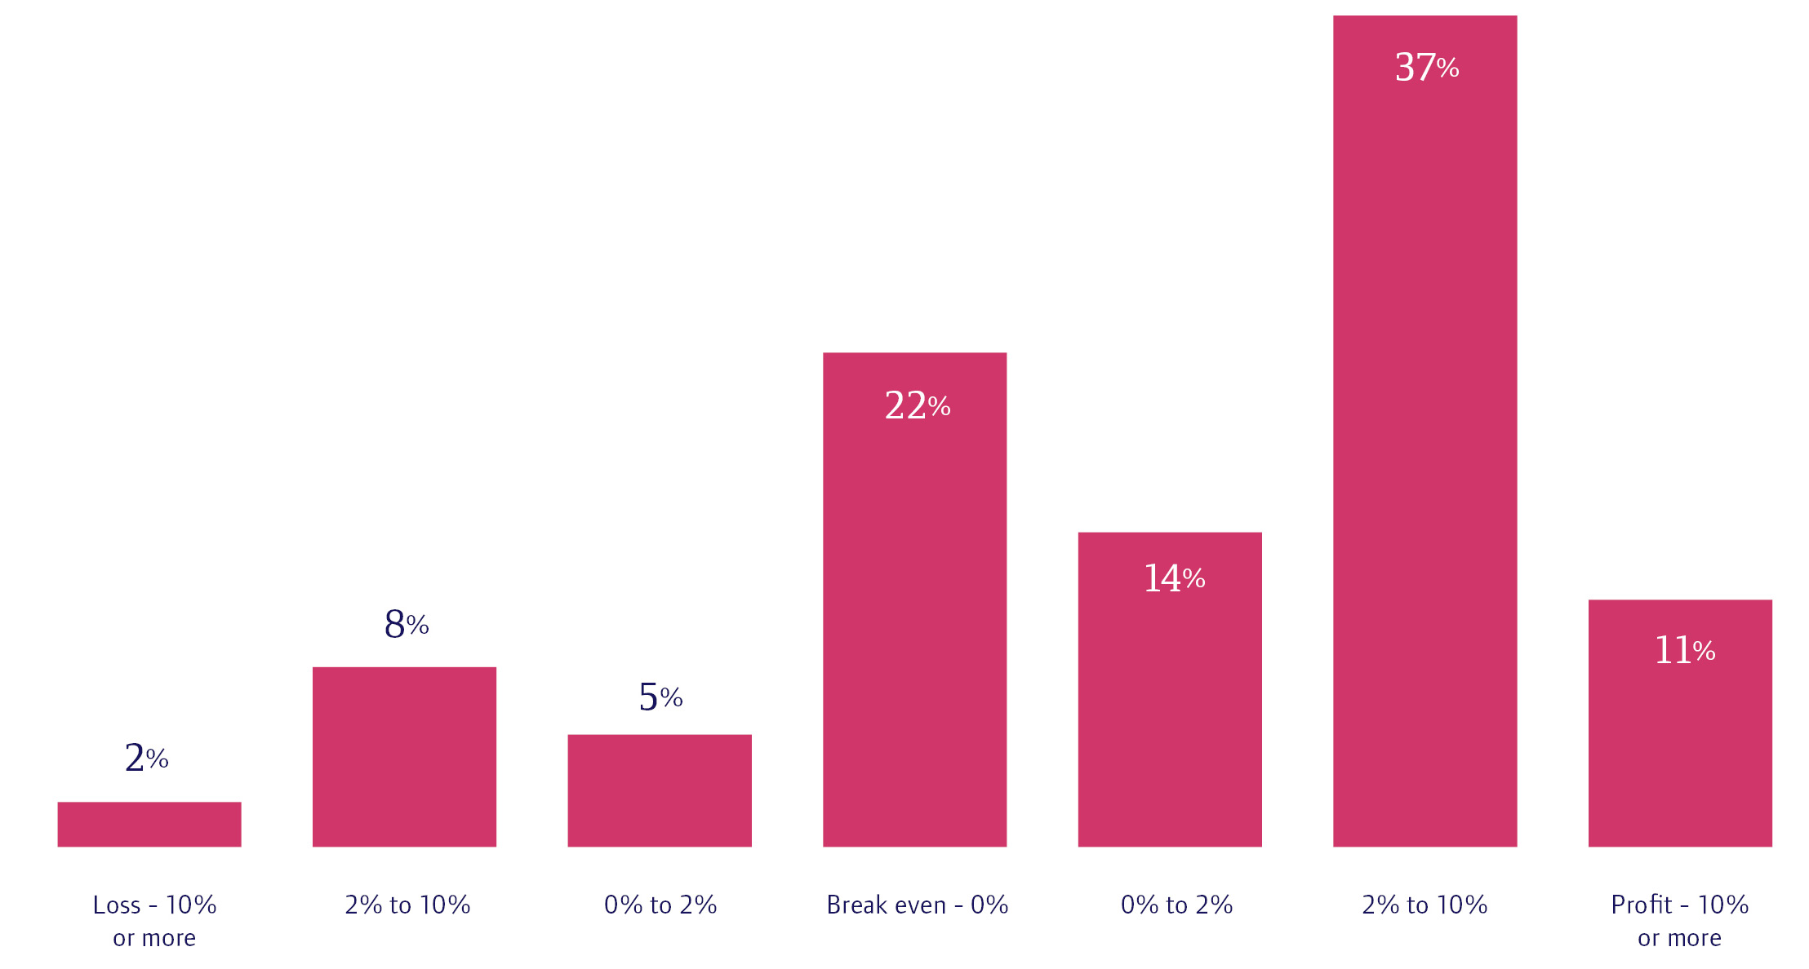
2017 NFP GOVERNANCE AND PERFORMANCE STUDY
Achieving financial sustainability
Figure 11:

Slide 9
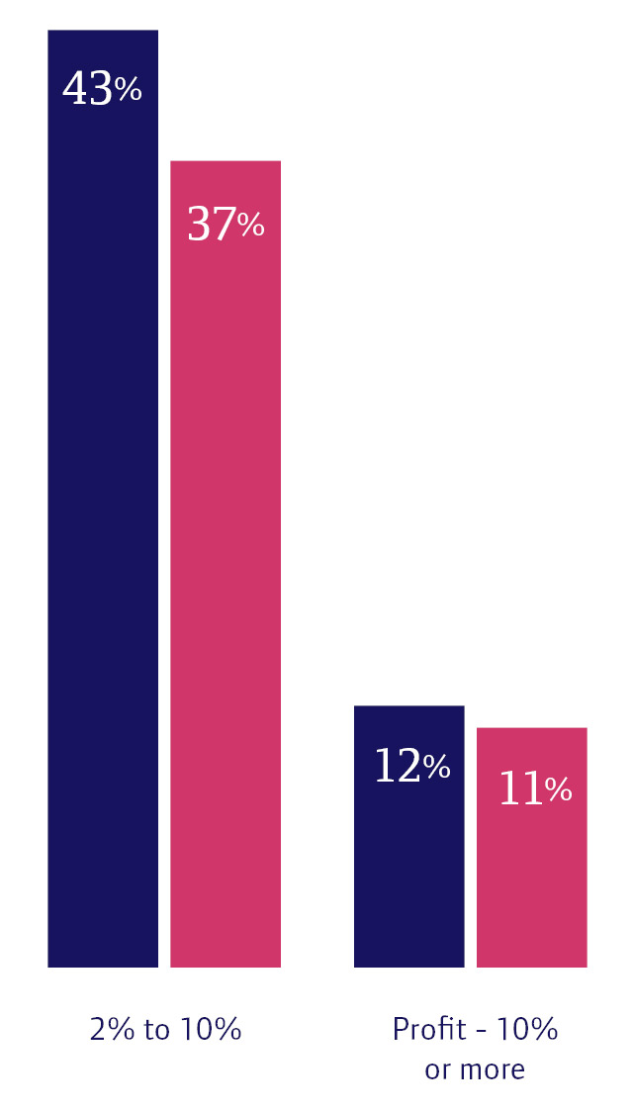
2017 NFP GOVERNANCE AND PERFORMANCE STUDY
Achieving financial sustainability
Figure 13:
Some deterioration in profit over the last three years
NFPs reporting margins of greater than 2% fell from 55% to 48%

Slide 10
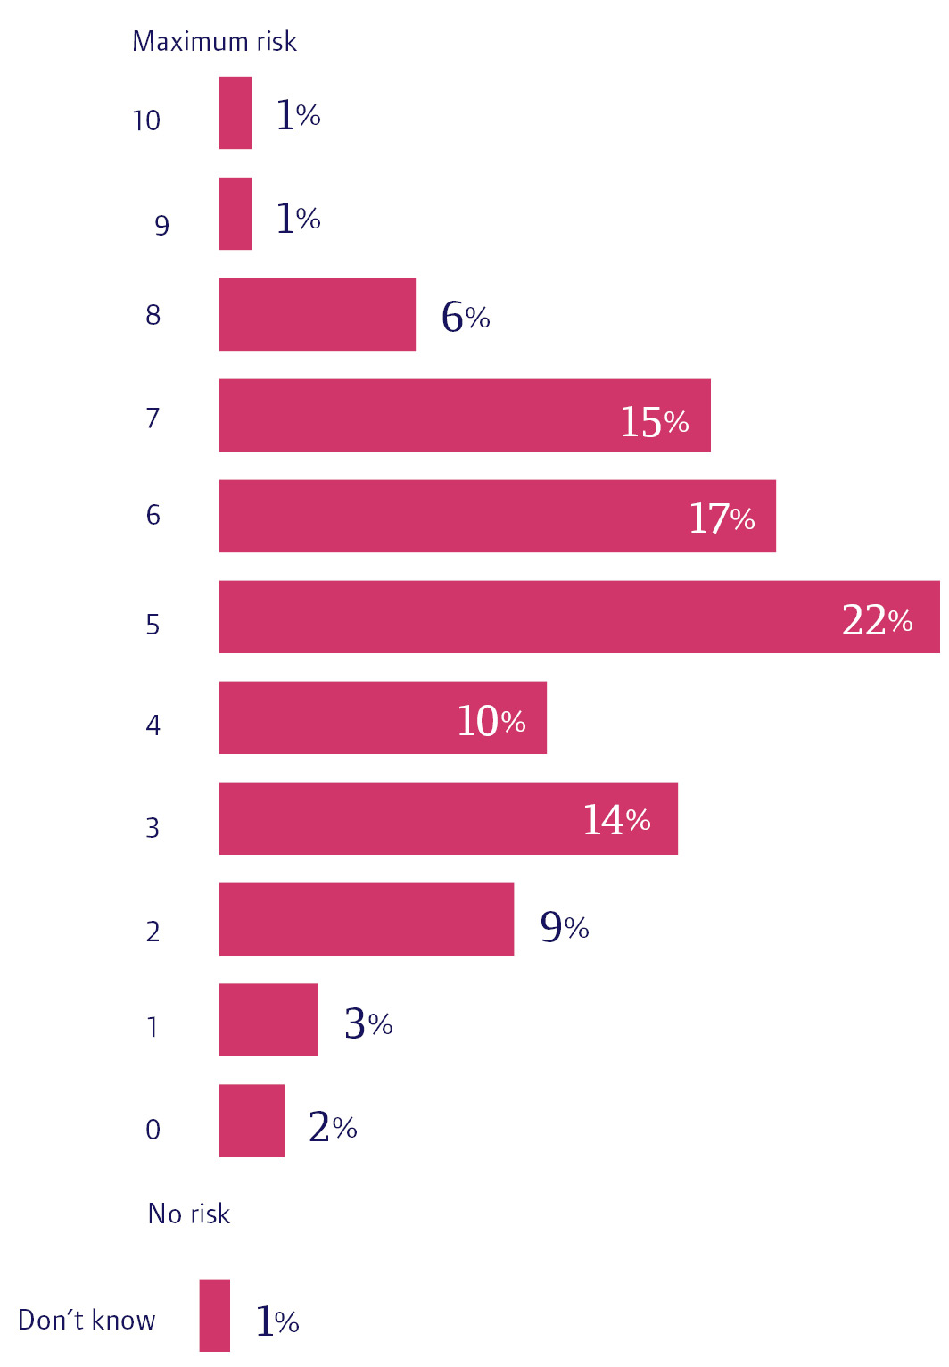
2017 NFP GOVERNANCE AND PERFORMANCE STUDY
Risk and reputation: management highly variable
“To provide the services we do in the places we do involves risk that many companies would never dream of.”
There is no one risk story
NFPs aren’t more risk-averse than the for-profit sector
49% of directors placed themselves around middle values on risk spectrum
28% said their NFP is risk-averse
23% said risk-willing
Figure 5:

Slide 11
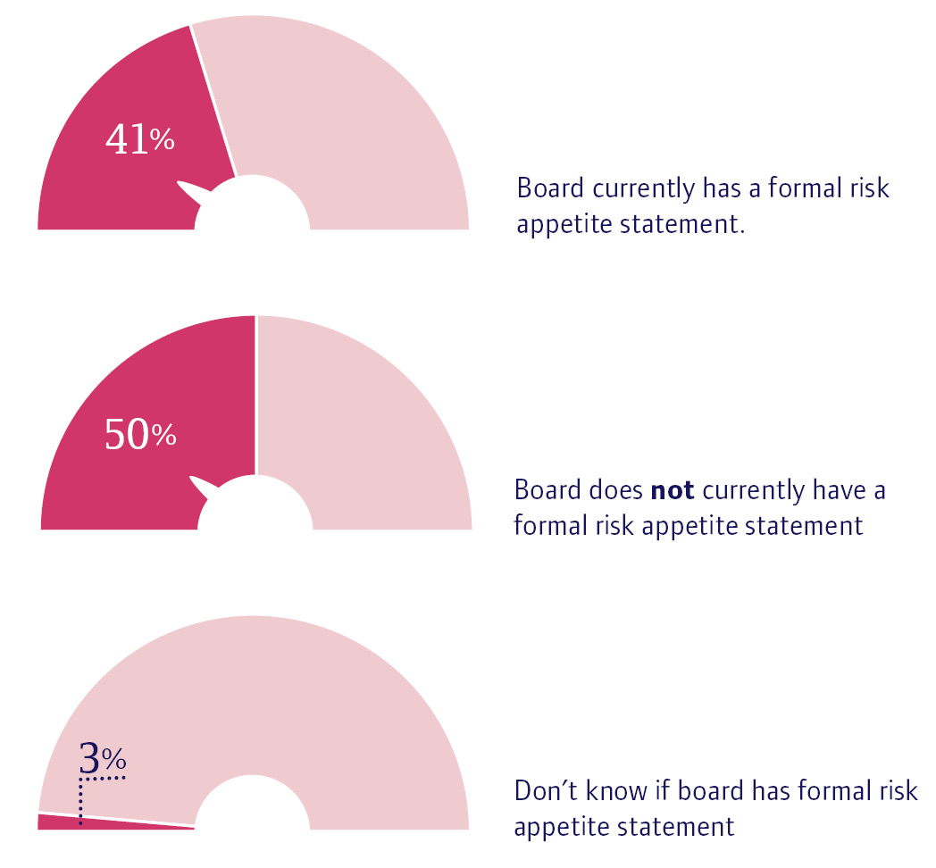
2017 NFP GOVERNANCE AND PERFORMANCE STUDY
Risk and reputation: management highly variable
Figure 8:
Formal risk management is underdeveloped
50% said board does not have a formal risk appetite statement
Only 48% said risk is defined, overseen by the board and embedded in decisions.

Slide 12
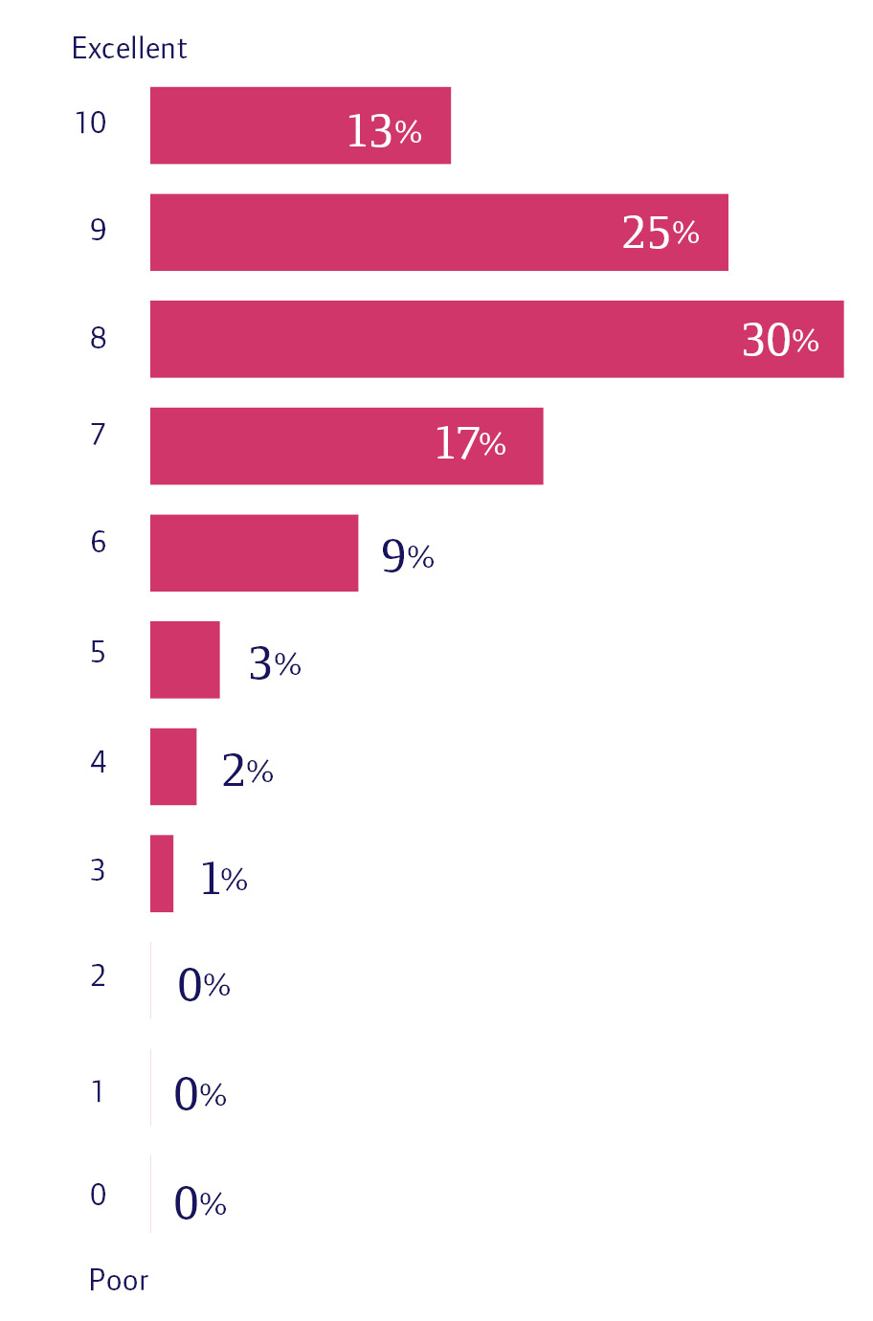
2017 NFP GOVERNANCE AND PERFORMANCE STUDY
Risk and reputation: management highly variable
Figure 15:
Directors are near unanimous on the importance of reputation
97% said it is very important for their organisation
“Reputation is a complete showstopper”
Directors are confident in their organisations’ reputation

Slide 13
2017 NFP GOVERNANCE AND PERFORMANCE STUDY
Risk and reputation: management highly variable
More than two-thirds thought their organisations reputation was very good or excellent.
But… again
Only 41% said reputation is agreed by the board and formally considered in decision-making

Slide 14
2017 NFP GOVERNANCE AND PERFORMANCE STUDY
2017 NFP Governance & Performance Study
Key Data
1,928 Respondents
9 Focus Groups
50% had turnover greater than $5million
22% had turnover of less than $1 million
42% female

Slide 15
2017 NFP GOVERNANCE AND PERFORMANCE STUDY
2017 NFP Governance & Performance Study
Key Data
38% discussed merger
77% rated their organisation as effective
78% rated their governance as improved
75% over 50
90% had more than 1 years experience

