Slide 1
Sarah Mackenzie Dodds Team Manager Child and Youth Team Mental Health Central Australia Health Service
CROSS SECTION ORIENTATION WORKSHOP – Alice Springs
25th May 2017

Slide 2
CROSS SECTION ORIENTATION WORKSHOP
Mental Health Services in Central Australia
Mental Health Central Australia Health Service
Mental Health Association of Central Australia (MHACA)
Mental Illness Fellowship of Australia (NT)
(4) headspace

Slide 3
ADMINISTRATION TEAM
COMMUNITY TEAM
SAFETY & QUALITY TEAM
BARKLY TEAM
CRISIS & ASSESSMENT TRIAGE TEAM (CATT)
REMOTE TEAM
MENTAL HEALTH
CENTRAL AUSTRALIA HEALTH SERVICE
MENTAL HEALTH UNIT
CHILD & YOUTH TEAM
CONSULTATION LIAISON TEAM
PERINATAL MENTAL HEALTH TEAM
MEDICAL TEAM
SUB ACUTE UNIT
FORENSIC TEAM

Slide 4
COMMUNITY MENTAL HEALTH TEAM
Glenn Murray – Team Manager
Community Case Management Team
Case management service for people aged 18 years and above
Located at Stuart Terrace (next to Royal Flying Doctor Service)
Outreach service available where possible
Crisis Assessment Triage Team (CATT)
24 hour crisis intervention and treatment telephone support service - 1800 682 288 or through hospital switchboard 8951 7777
Should be used for all urgent enquiries from people experiencing a mental health crisis or with concerns about another person's mental health wellbeing
In an emergency (serious risk of safety to self and/or others) people experiencing mental health crisis should be taken to the Emergency Department at Alice Springs Hospital

Slide 5
COMMUNITY MENTAL HEALTH TEAM Glenn Murray – Team Manager
This is a multi-disciplinary team of Nurses and Allied Health Professionals who provide community services in Alice Springs for adults with serious mental illness and associated disability and / or risk which requires interventions by specialist mental health services. This Team is sub divided into a Crisis Assessment Triage Team (CATT) and a Community Case Management Team (CMHT).
Both Teams provide service to people over 18 who have a diagnosed mental illness.
The CATT has the primary function to act as a first point of contact for most people accessing Mental Health Services who may be experiencing mental health issues.
CATT provides a single point of contact for clients wishing to contact the mental health services on a 24 hours, 7 days a week basis, in Alice Springs the Team operates from 07.00 to 23.30; after-hours clients can access CATT services via NTCATT [which provides a Territory Wide telephone triage service]. Alice Springs based clients can access CATT after hours, as well as an on call Psychiatric Registrar and Consultant to assess clients at the Alice Springs Hospital ED if necessary.
If severe disability persists the Community Mental Health Team offers longer-term treatment coordinated by a Case Manager together with links to other allied health services programs and at times is able to provide Assertive Outreach to some of the client base.
The Community Mental Health Team is located on Stuart Terrace and backs on to the ASH campus.

Slide 6
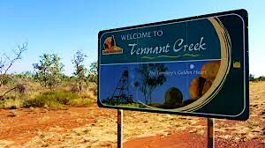
Barkly Mental Health Team
The Barkly Team are based in Tennant Creek
Provides assessment and case management to residents in the Barkly Region with mental health issues
Includes outreach to Elliott, Ali Curung, Epenarra & Canteen Creek
Provides a service to adults, and to children and young people with serious mental health difficulties

Slide 7
Mark Sheldon Remote Mental Health Team Josephien Rio – Team Manager
Multi –disciplinary team of Mental Health Nurses, Social Workers and Psychiatrists that travels throughout Central Australia
Also employs two senior Aboriginal Health Workers, Phyllis Gorey and Marjorie Lindner
Services 28 communities including Kintore, Willowra, Mutitjulu, Docker River, Bonya
Works with local remote health clinics, NGOs and other regional services
Works closely with Royal Flying Doctor Service’s primary mental health team
Provides support to people with a mental Illness (mainly acute), or who need assistance in maintaining their mental wellbeing. This is an adult service though some young people may be seen at times

Slide 8
Mental Health Unit Gina Roy – Team Manager
The team has Mental Health Nurses, Personal Care Assistant's, Psychiatrist's, an Occupational Therapist, a Social Worker and an Aboriginal Health Worker
Provides inpatient services for adults with a serious mental illness needing structured intervention in an acute care hospital setting (at times young people over 16yrs with serious acute mental health difficulties may be considered for a brief stay if appropriate)
Services for both voluntary and mandated clients as per the Mental Health and Related Services Act
12 bed unit (8 general and 4 high dependency)

Slide 9
Sub Acute Mental Health Facility Megan Holmes – Team Manager
Provides recovery-focussed care for people in a residential setting
Consists of 6 beds for short-term support
Has 2 other beds for longer-term supported accommodation
Often can be used as a step-down from the Mental Health Unit when someone is needing further recovery but does not need an acute setting

Slide 10
Forensic Mental Health Team Dorothy Jamela – A/Team Manager
Based at the Alice Springs Correctional Centre
Service for people in the criminal justice system charged with an offence and who have a serious mental illness
Staff work in the prison and the community
Provide direct clinical services to adult prisoners
Provide education to prison officers on mental illness
Support clients on parole in the community

Slide 11
Child & Youth Mental Health Team Sarah Mackenzie Dodds – Team Manager
Provides mental health assessment, support, and therapeutic work and to children and young people of Alice Springs from 3-18 years of age who are experiencing moderate to severe mental health concerns. These can include:
Depression and anxiety disorders
Self-harm and suicidal behaviours
Extreme behavioural concerns
Eating disorders
Trauma
Attachment disorders
A multi-disciplinary team of Social Worker’s, Occupational Therapists, Mental Health nurses, Clinical Psychologists, and Child & Adolescent Psychiatrists
Referrals are accepted from anyone, including GP’s, schools, parents, other services and self-referrals

Slide 12
PERINATAL MENTAL HEALTH SERVICE Amanda Worrall – Perinatal MH Nurse
Provides a specialist Mental Health Service to pregnant women and mothers in Alice Springs who are up to 12 months post-delivery with moderate mental health issues (this does not include acute difficulties – this would be referred over to the Community Team)
Amanda is based at the Child and Youth Team and works across a number of services including Flynn Drive Health Centre and the Midwifery Group Practice
Amanda provides a number of options for treatment and support, including mental health assessment, individual therapeutic sessions and she also delivers some group work
Referrals can be made by GP’s, midwives, Child and Family Health Nurses and Obstetricians

Slide 13
Other Mental Health Services in Alice Springs
Mental Health Association of Central Australia (MHACA)
Lifeline
Mental Health Fellowship
Headspace Alice Springs

Slide 14
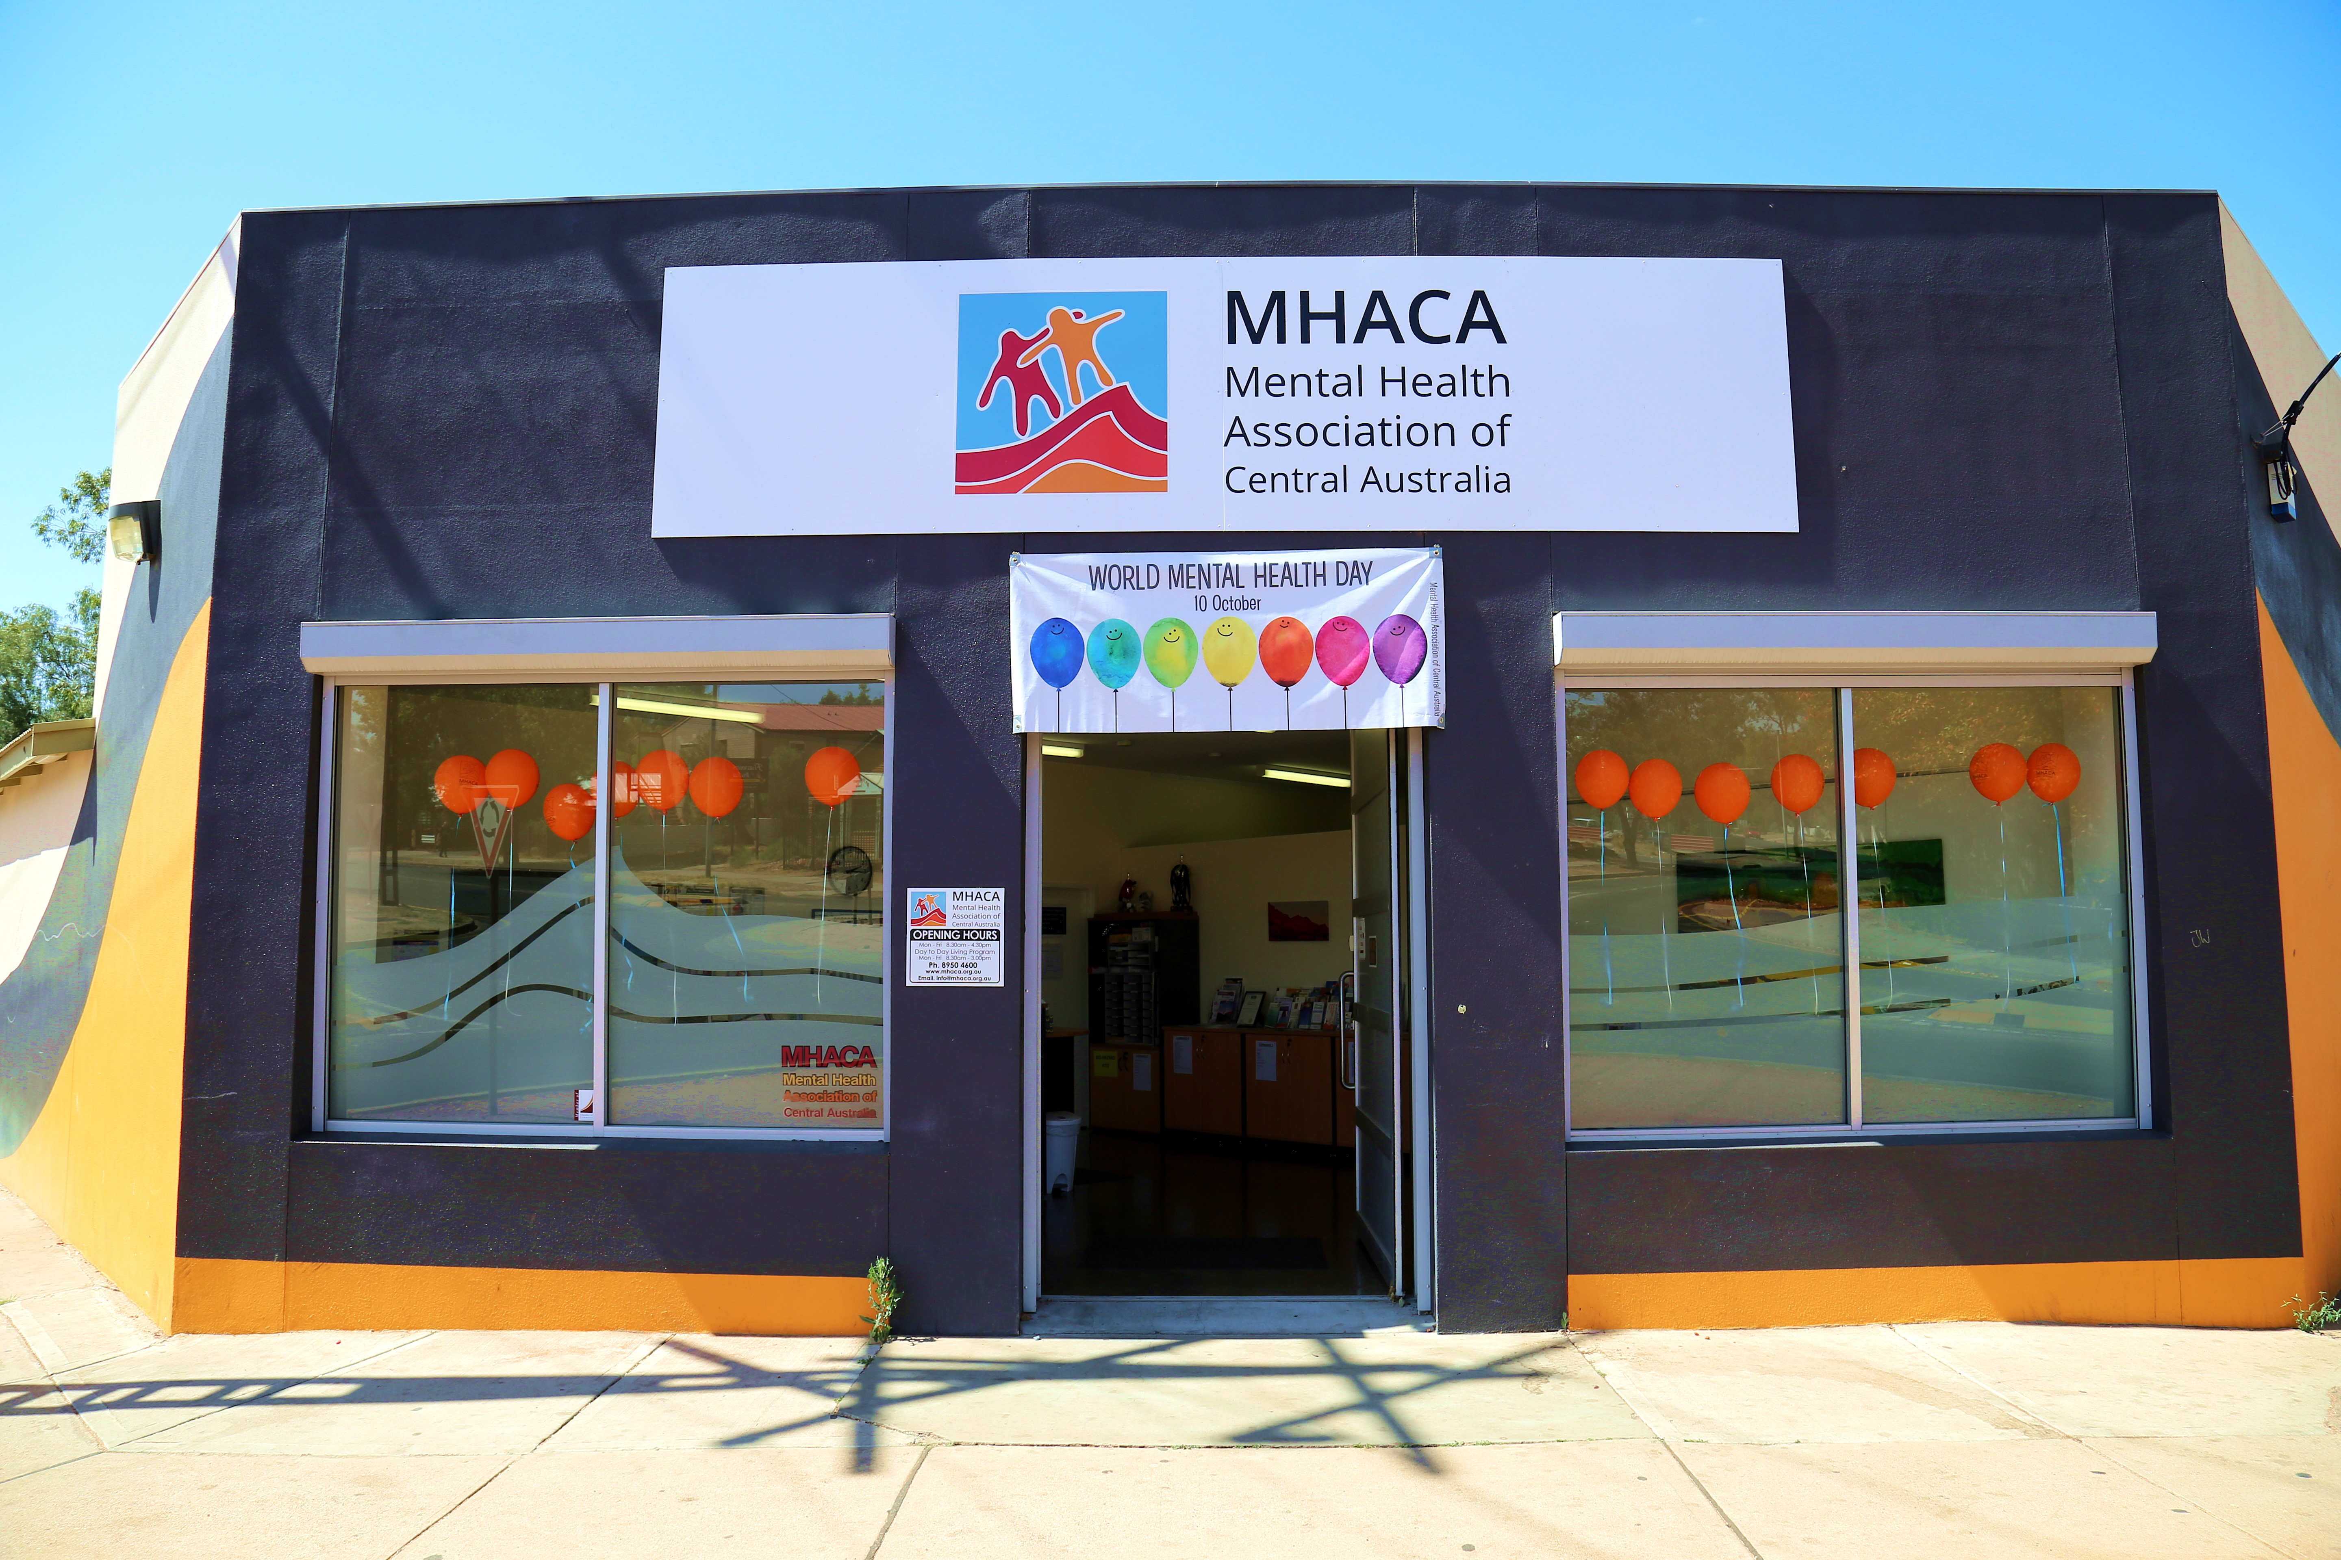
Mental Health Association of Central Australia (MHACA) 14 Lindsay Avenue Alice Springs 0870 www.mhaca.org.au

Slide 15
Mental Health Association of Central Australia (MHACA) 14 Lindsay Avenue Alice Springs 0870 www.mhaca.org.au
Community-based, non-profit organisation that aims to improve services and quality of life for people aged 18 and over experiencing mental illness, their families and carers
Individual support
Education and training including Mental Health First Aid and suicide intervention
Mental health promotion to raise community awareness and reduce stigma
Drop-in centre and peer support program, and have a range of weekly social and recreational activities
Advocacy work at local, state and national level and support for participant involvement

Slide 16
Lifeline Central Australia
Lifeline Central Australia incorporated opened in Alice Springs in July 2003
Their primary focus is on community education and training, particularly focusing on suicide awareness and prevention
Lifeline provides a number of training courses which are delivered by qualified and experienced trainers
Contact 89531250 to find out more

Slide 17
Mental Illness Fellowship of Australia (NT) Location: 3/58 Reg Harris Lane Tel 8953 1467 www.mifant.org.au
Mental Illness Fellowship of Australia (NT) (MIFANT) is a non-government organisation providing support, advocacy, information, referral and education for carers, family, friends and people affected by mental illness
CARERS PROGRAM
Individual and Group Support for family and friends to help cope and care; carer drop-in
Respite programs offering time-out for carers
Information, Education & Advocacy
MI TRACK PROGRAM
Free service for children/youth aged 6-18 who are at risk of or experiencing early signs of mental illness
Alice Springs, Tennant Creek, Elliott and Ali Curung
Must have a parent, carer or significant other adult willing to engage with the program
Young person must not be current Territory Families client
Aims to help the young person work with their parent/carer to assist them to build their strengths to achieve their goals and get more enjoyment out of life
Relationship-building program – not therapeutic

Slide 18
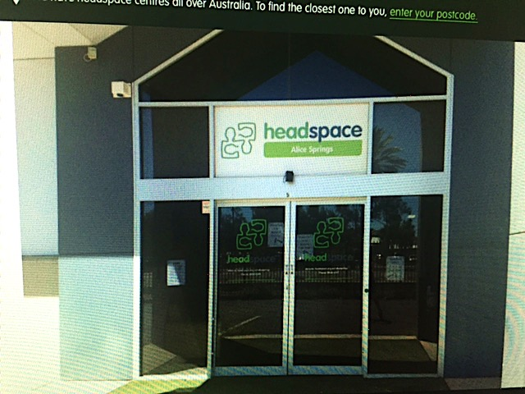
Headspace Alice Springs 5/5 Hartley Street; Tel. 8958 4544 ; headspace.org.au
headspace Alice Springs is a free and confidential service for all young people aged 12 – 25 years. Referrals are accepted from anyone, including self-referrals
They provide mental health and alcohol and drug counselling, a GP and nurses clinic for all physical and sexual health needs and general support and information for young people
They run a number of youth events and participation groups, including the headspace Youth Advisory Group which contributes to the development of headspace and inputs into the wider community. Contact Neily at headspace if you want to know more

