Slide 1
Alcohol and other Drugs (AOD) Services in Central Australia Max Yffer A/General Manager – ADSCA (Alcohol and other Drugs Services Central Australia)

Slide 2
What is a drug?
“A medicine or other substance which has a physiological effect when ingested or otherwise introduced into the body.” – English Oxford Dictionary
Notes:
Drugs can be beneficial and help treat conditions, or they can have detrimental effects on the body, even though the perceived initial effect may be positive.

Slide 3
Notes:
Here’s a pill box from yesteryear aimed at helping mothers get through their busy days!
This was the official pill box for: Valium (Benzodiazepine) – anti-anxiety, alcohol withdrawal symptoms, muscle spasms etc.

Slide 4
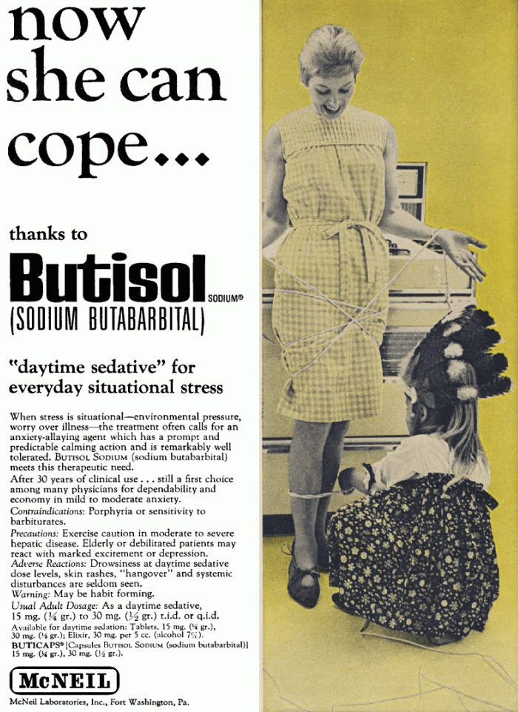
Notes:
Another ad from days gone by: another drug aimed at assisting people (again aimed at women): a “daytime sedative for everyday situational stress”.

Slide 5
Services That Can Assist
W
Alice Springs
Alcohol and other Drugs Services Central Australia (ADSCA)
Central Australian Aboriginal Alcohol Programmes Unit (CAAAPU)
Drug & Alcohol Services Association (DASA)
Central Australian Aboriginal Congress (Social and Emotional Wellbeing)
Headspace
Holyoake
BushMob
Remote AOD Workforce
Tennant Creek
Alcohol and other Drugs Services Central Australia (ADSCA)
Barkly Region Alcohol and Drug Abuse Advisory Group (BRADAAG)
Notes:
This is the World Health Organisation definition of what a drug is. Depending on time you might like to use this or encourage the group to develop their own definition. To start the thinking process ask the group to brainstorm what drugs they know of and write these on the board. Follow up by asking what the term drug means to them.

Slide 6
ADSCA – Alcohol and other Drugs Services Central Australia (NT Dep of Health) 2 Stuart Terrace (also at 172 Patterson St Tennant Creek)
Services
Assessment
Withdrawal
Opiate Substitution Therapy
Specialist Counselling
Volatile Substance Abuse case management
Volatile Substance Abuse Management Plans
Alcohol Mandatory Treatment (Alice Springs Alcohol Assessment Service)
Education
Training
Medical support
Criteria
Tobacco, alcohol, all other drugs
Adults, juveniles, families
Notes:
Existing VSA Management Plans: Hoppy’s Camp, Larapinta Valley Camp, Alpurrurulam (Lake Nash), Papunya, Mt Liebig, Ntaria (Hermannsburg), Ikunji (Haasts Blufff), Kaltukatjara (Docker River); current submission for Ali Curung. Require at least 10 community member signatures.
Can lead to restrictions on sale/possession of substances e.g. spray deodorants, glues, paints, cleaning agents, thinners, solvents.

Slide 7
BushMob 36 Priest Street
Services
Residential - 24 hour care
20 beds
Case management
Outreach
Counselling
Brief interventions
VSA and AOD program
Life skills development programs
Criteria
12-25 years
Substance abuse
Violence
Unsafe living environment

Slide 8
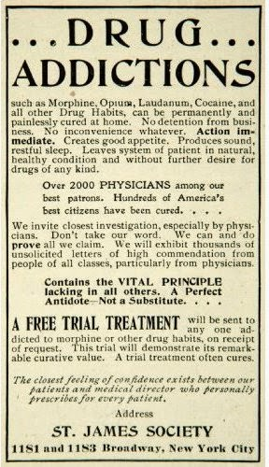
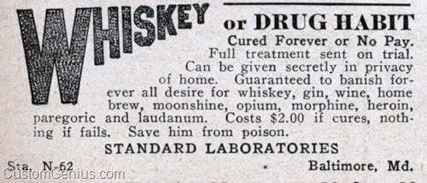
Notes:
First ad: Guaranteed to banish forever all desire for… Save him from poison!
Second ad: …permanently and painlessly cured at home
…no inconvenience whatever
…The closest feeling of confidence…

Slide 9
CAAAPU – Central Australian Aboriginal Alcohol Programmes Unit 290 Ragonesi Road
Services
Residential 8 week program
35 beds
Counselling
Outreach service
Alcohol Mandatory Treatment – residential 3 month program
Criteria
Adult
Aboriginal
Alcohol

Slide 10
Central Australian Aboriginal Congress Social Emotional Wellbeing (SEWB) – 14 Leichhardt Terrace
Services
Counselling/Psychology
Brief interventions
Social support
Medical support
Outreach
Criteria
Adult
Aboriginal
Notes:
Looking at extending Satellite services (Larapinta, Sadadeen) to include counselling services.

Slide 11
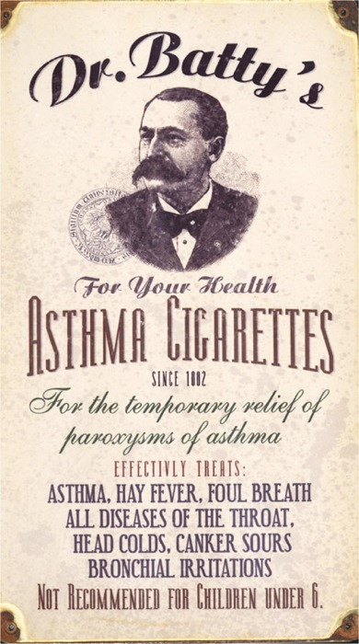
?
Notes:
Q. What treatment is being promoted here?

Slide 12
Notes:
Q. What treatment is being promoted here?

Slide 13
DASA – Drug and Alcohol Services Association Schwarz Cres and Kempe Street
Services
Aranda House residential 12 week program
20 beds
Transitional After Care Unit
Independent Living Program
Sobering Up Shelter
Outreach
Brief interventions
Counselling
Methamphetamine (ICE) Program
Criteria
Adult
Alcohol and other drugs
Notes:
Methamphetamine (ICE) Program (beginning July 2017)
Kempe St = Aranda House

Slide 14
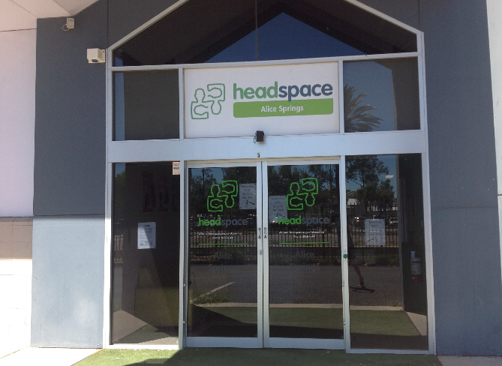
Headspace 5/5 Hartley Street
Services
Counselling
Medical support
Criteria
12 – 25 years

Slide 15
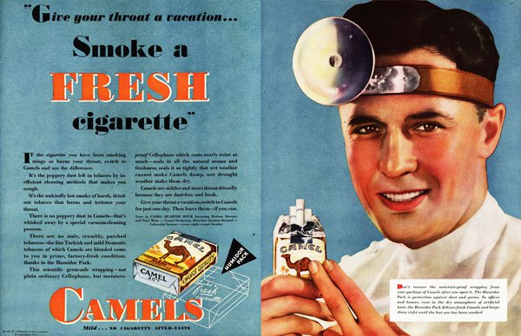
Notes:
Couple of old ads promoting the health benefits and freshness of smoking cigarettes – “give your throat a vacation…smoke a fresh cigarette”
Endorsed by your doctor – so it must be good!

Slide 16
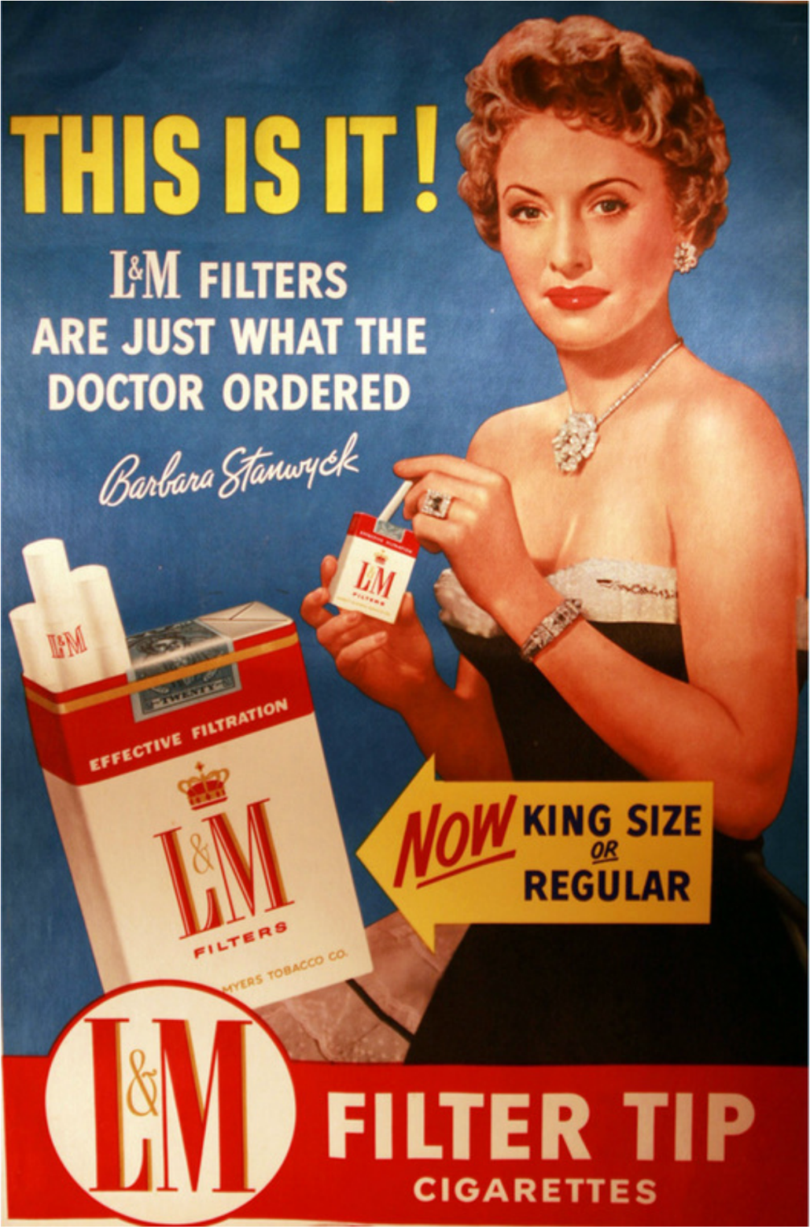
Notes:
And another one: these cigarettes are just what the doctor ordered! And, in addition to medical endorsement, backed by a movie star!

Slide 17
Holyoake 21 Newland Street
Services
Managing Your Life program – 12 week program for people with alcohol, drugs, other addictions
Skills For Life program – 12 week program for people affected by alcohol, drugs, other addictions
Young People’s Program (Youth)
Sandplay Therapy (5 years +)
Counselling
Criteria
5 years +
Alcohol, drugs, gambling…

Slide 18
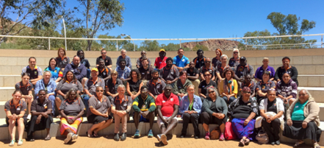
Remote AOD Workforce (NT Dep of Health)
Services
Coordinate AOD workers in remote areas
Based in Aboriginal Medical Services (AMS) & DoH Primary Health Care Clinics
AMS include CAAC (Santa Teresa, Mutitjulu), WAHAC (Ntaria), Wurli (Katherine), Anyingimyi (Tennant Creek) Miwatj Health (Nhulunbuy), Danila Dilba (Darwin)
DoH PHCC include Borroloola, Jabiru, Elliott, Ali Curung, Titjikala, Aputula (Finke), Yuendemu, Ti Tree
Provides a culturally appropriate service to people that currently have limited access to AOD services

Slide 19
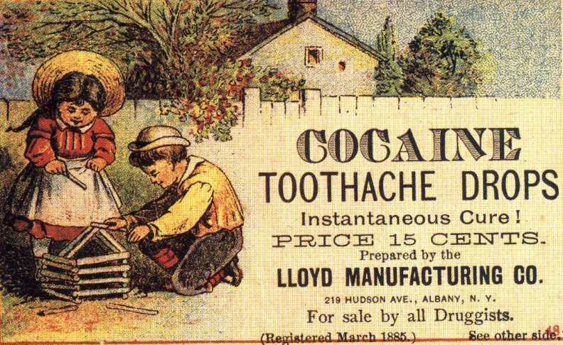
?

Slide 20
Notes:
We once lived in a world when cocaine was in nearly everything — pain relievers, muscle relaxers, wine, fountain drinks, cigarettes, hair tonics, feminine products. It was therapeutic, a “nerve stimulant,” a natural remedy and an over-the-counter drug sold in a variety of forms and doses. The coca plant, to many, was “the most tonic plant of the vegetable world.” [source]
The coca byproduct popped up in a variety of medicinal and recreational forms in the 1880s. In particular, New Yorkers were wild about cocaine, especially those in the medical community.
“The therapeutic uses of cocaine are so numerous that the value of this wonderful remedy seems only beginning to be appreciated,” said the New York Times in 1885. “The new uses to which cocaine has been applied with success in New York include hay fever, catarrh and toothache and it is now being experimented with in cases of seasickness.” They later report that even asthma could be eradicated by it.
Cocaine was the wonder drug of the early 1880s. Not only could it cure disease; it could also dampen the senses. In 1884, a doctor presented his findings at the College of Physicians and Surgeons (23rd/Park Avenue), heralding the successes of “anesthetic cocaine” in numbing patients during ear and eye surgeries. It was even given as a pain reliever to horses.

Slide 21
BRADAAG – Barkly Region Alcohol and Drug Abuse Advisory Group 29 Staunton Street, Tennant Creek
Services
Residential 8 weeks
20 beds
Sobering Up Shelter
Transitional Aftercare Program
Outreach
Family residential rehabilitation
Criteria
Adult

Slide 22
QUESTIONS?

