Slide 1
Territory Families
Southern Region
Lisa Palamountain and Sarah Codrington
Territory Families
Notes:
Territory Families works with families, individuals and stakeholders to create stronger communities where children experience safe, healthy and happy childhoods; women and men from all cultural and linguistic backgrounds have equal opportunities; and senior Territorians are appreciated and respected.
Territory Families encompasses Children and Families; Domestic Violence Directorate; Office of Women’s and Men’s Policy, Children’s Policy; Youth Justice; Seniors and Pension Concessions; Youth, Multicultural Affairs and Seniors (from Department of Chief Minister).
On the ground, Care and Protection, Domestic Violence, Pensioner Concessions and Youth Justice services are provided.

Slide 2
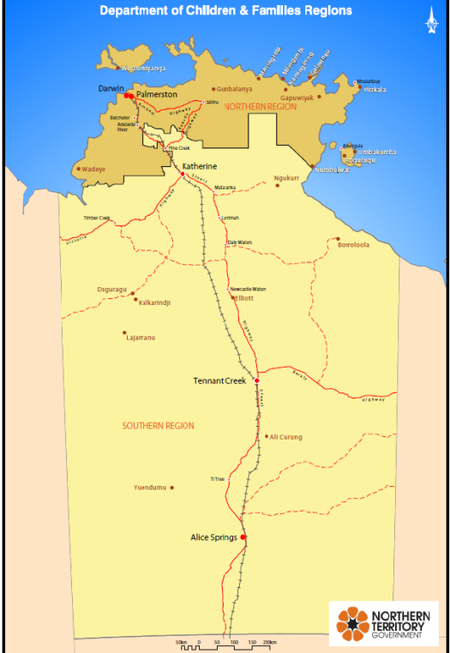
Southern Region Overview
Notes:
The Southern Region is responsible for the geographical area east, south and west to the Territory's borders and north to Elliott. The region provides services from two offices (Central Australia and Barkly).

Slide 3
Geographical Service Delivery
Catchment Model
The Southern Region operates a ‘catchment’ approach to case allocation meaning Child Protection Practitioners are designated to communities, enabling relationships and knowledge to grow, and the efficiency of casework to be maximised (i.e. staff could conduct work on multiple cases per travel event).
Notes:
The Southern Region operates a geographical catchment approach to case management meaning Child Protection Practitioners are designated to specific communities enabling service delivery efficiencies and to further strengthen relationships with children, families, and communities.

Slide 4
Southern Region Care and Protection
Teams
Investigation and Assessment
Child Abuse Taskforce
Strengthening Families
Reunification
Long Term Care
Carers and Residential Care
Business Services
Notes:
I&A - The Investigation and Assessment Teams work within a 28 day timeframe to assess the protective needs of children who have been notified to Central Intake and it has been determined a child may have been harmed or is at risk of harm as defined by Sections 15 and 20 of the Care and Protection of Children Act (2007).
CAT - The Child Abuse Taskforce (CAT) consists of departmental Authorised Officers, Northern Territory Police and members of the Australian Federal Police. This multi-disciplinary approach enhances the effectiveness of the investigation process by minimising the number of interviews with each child and drawing on a wide range of skills, knowledge and experience.
SF - The Strengthening Families Team work with children who are assessed by the Investigation and Assessment Teams as needing ongoing case management by Territory Families to ensure their safety and protection with the primary goal of preventing the children entering the care of the Chief Executive Officer, Territory Families.
Reunification - The Strengthening Families Team work with children who are assessed by the Investigation and Assessment Teams as needing ongoing case management by Territory Families to ensure their safety and protection with the primary goal of preventing the children entering the care of the Chief Executive Officer, Territory Families.
Long Term Care - The Long Term Care Teams work with children who are in the care of the Chief Executive Officer, Territory Families where their care plan goal is to ensure stability and permanency in the care of the Chief Executive Officer, Territory Families. Child Protection Practitioners’ and Aboriginal Community Workers’ primary focus is to ensure children have plans in place for all of their needs including, but not limited to; education, social skills, health and development for the length of their childhood/young adulthood. A critical part of the Team’s work is to strengthen relationships between the children /young people and their immediate and extended family. The teams’ work culminates in ‘Transition From Care’ planning for young people from the age of 15 years to support young people to work towards their goals and for them to successfully enter adult life.
CARCS – Provide residential care in two sites and assessment of and support to potential or authorised kin and foster carers.
BST - The Business Services Team provides high quality business administrative advice and support in accordance with relevant legislation, policy and procedure requirements to the Southern Region while enabling frontline staff to protect children from harm and optimise outcomes for children in care of the Chief Executive Officer, Territory Families.

Slide 5
Southern Region Teams
Youth Justice
Domestic Violence Directorate
Pensioner Concessions
Notes:
YJ – Youth Justice Services including the Owen Springs Detention Centre, Youth Outreach and Reengagement Team and the development of bail accommodation options
DV - The Domestic Violence team delivers support and referral services for victims of domestic and family violence by working collaboratively across government agencies and non-government organisations to address the negative impact of service fragmentation for vulnerable people. The team implements the Northern Territory Domestic and Family Violence Reduction Strategy 2014-2017 – Safety is Everyone’s Right at the regional level, inclusive of the project management of the Critical Intervention Outreach Services (Remote and Urban), the Sexual Assault Specialist and the Domestic Violence Specialist Children’s Service. Local Reference Groups operate in Alice Springs and Tennant Creek. The Family Safety Framework is established in Alice Springs, Tennant Creek and Yuendumu to provide an action based integrated service response to high risk domestic and family violence victims and their children.
Pensioners - The Northern Territory Pensioner and Concession Scheme, and Seniors Card Scheme are currently transitioning their shop fronts from the Department of Health to Territory Families. The Northern Territory Pensioner and Carer Concession Scheme (the Scheme) has two objectives:
•to provide an incentive for members to remain in the Northern Territory following their retirement; and
•to assist all pensioners generally and certain categories of other low-income earners with a range of cost of living expenses.
The Scheme encourages people to remain in the Northern Territory following their retirement through the provision of concession on a number of cost of living expenses. Concessions ensure ongoing independence and mobility for many people who would otherwise be further financially and socially disadvantaged following their retirement and a reduction in disposable income and access to community networks.

Slide 6
Mandatory Reporting
Child Abuse and Neglect – 1800 700 250
Domestic Violence – 131 444 or 000 in an emergency
Notes:
Child Abuse - Everyone over the age of 18 years is mandated to make a report if they believe a child has been, or is likely to suffer harm or exploitation or be a victim of a sexual offence.
Physical Harm
Is all non-accidental physical injuries or impairments or where there is significant risk of injuries occurring.
Physical harm can be caused by actions such as the child being kicked, punched, slapped, shaken, bitten or burnt.
Sexual Harm
occurs when any sexual activity or sexual threat is imposed on a child.
It includes the inducement or coercion of the child to engage in or to witness sexually explicit conduct for sexual gratification of the person responsible.
Sexual Offence
Sexual intercourse, oral sex, indecent dealing and exposure to pornographic material with a child under 16 years, regardless of consent or the age of the other person.
Sexual intercourse by an adult with a young person between 16-18 years, where the adult is in a caring role (e.g. teacher, guardian), regardless of consent or the age of the other person.
Emotional Harm
Occurs when a child’s social, emotional or cognitive development is impaired or is at significant risk as a direct result of the carer’s persistent failure to meet the child’s emotional need for love and security, or their psychological needs for stimulation/nurturing.
May include constant criticism, name-calling, rejection, exposure to domestic and family violence.
Neglect
Neglect is the repeated failure to meet a child’s basic physical and emotional necessities of life including supervision, shelter, nutrition, clothing, education, personal hygiene , or medical care.
Cumulative Harm
Effects of multiple adverse circumstances and events in a child’s life. The experiences of these prolonged and repeated events on the child can be profound and cumulative, diminishing a child’s sense of safety, stability and wellbeing.
DV - Everyone over the age of 18 years is mandated to make a report if they believe a person has caused, or is likely to cause, serious physical harm to someone they are in a domestic or family relationship with and/or the life or safety of a person is under serious or imminent threat, because domestic or family violence has been, is being or is about to be committed.

Slide 7
Questions and Answers Central Intake – 1800 700 250 https://territoryfamilies.nt.gov.au

