Slide 1
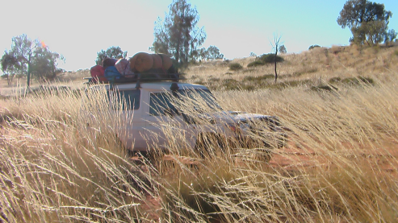
Cross Sector Orientation: remote services
Suzanne Bryce : NPY Women’s Council

Slide 2
The NPY Women’s’ Council was formed in 1980 and operates in the cross border region of the Northern Territory, South Australia and Western Australia, covering an area of 350,000 square kilometres (see map).
Anangu (Aboriginal people) living in Ngaanyatjarra, Pitjantjatjara and Yankunytjatjara lands (Western Desert language region) share strong cultural affiliations.

Slide 3
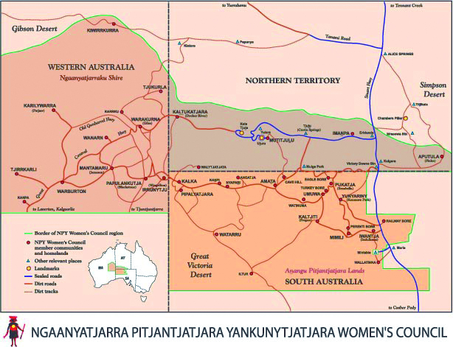
Map Area for NPYWC

Slide 4
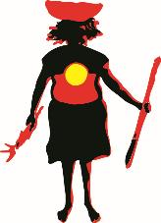
NPY Women’s Council
NPY Women's Council currently employs over 100 staff administering the following services:
Disability Advocacy and Support
Aged Care Support and Advocacy including Palliative
Carer Respite Regional Centre
Domestic Violence Service
Youth Services
Child Nutrition Program
Intensive Family Support Service – Walytjapiti
Child Advocacy Program
Ngangkari (traditional healer) Program
Uti Kulintjaku
Federal Emergency Relief funds
Tjanpi Desert Weavers

Slide 5
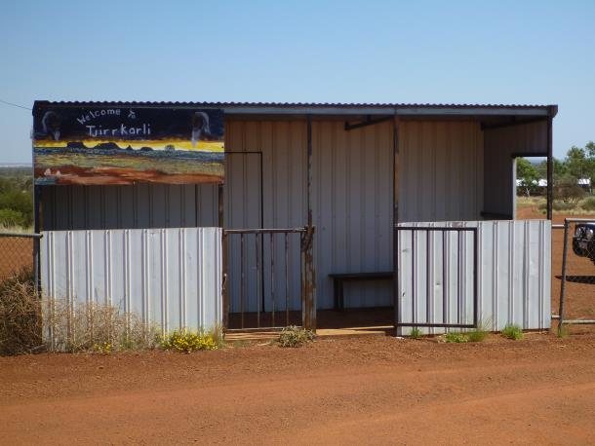
What is on communities
Core services: small places
Clinic
Primary School
Store
Community Office

Slide 6
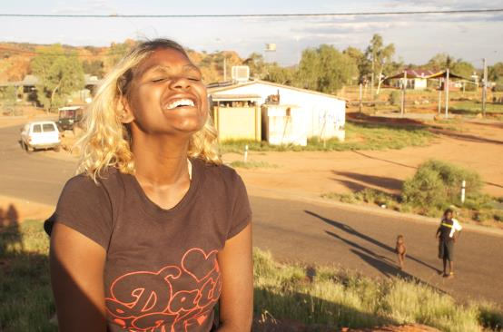
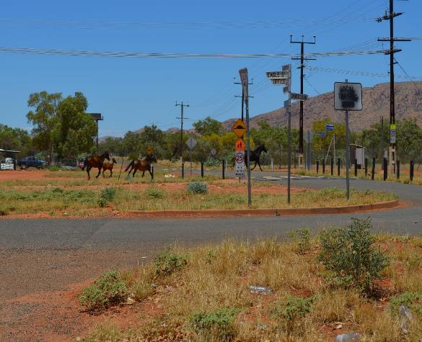
What is on Communities
Bigger communities may have
Police
Art Centre
Secondary School
Childcare/ASC
Night Patrol
Youth Programs
Family Centre
Centrelink agent
ATM
Renal Dialysis facility
Aged Care programs
Access to internet
Mobile phone coverage
Community media centre
Rangers
Child Protection (WA)

Slide 7
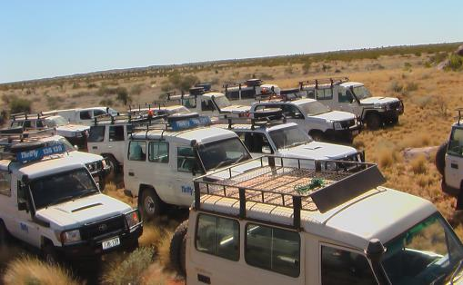
What is in communities
Visiting services
Allied Health
Vet
Mental Health services
Drug and Alcohol services
Child Protection
Centrelink
NT Housing
Contractors
Government consultants
Red Cross, Catholic Care,
Lutheran Community Care, MA,
World Vision, Save the Children
Legal Aid
Corrections
JSA
Financial Councellors

Slide 8
Working with community strengths
Family: foundation for Aboriginal community and identity. Several generations together.
Language: most Aboriginal people speak several Aboriginal languages.
Cultural strength through knowledge of language, kinship and country
Creativity, resourcefulness, flexibility, patience, humour
Hope for a good life and engagement with accessable services .

Slide 9
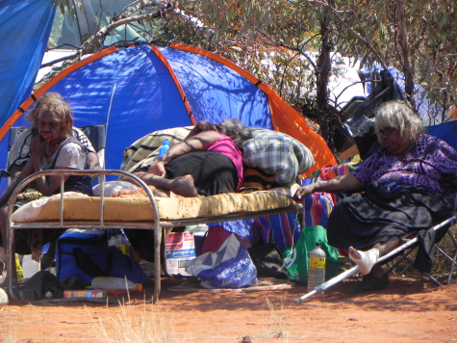
Challenges
Too many visitors – FIFO
Lack of appropriate work spaces
Conflicting priorities
Poverty
Remoteness
Health burden
Language, literacy
Interagency collaboration
Cultural differences,eg time
Lack of accommodation

Slide 10
Planning your visit
Who do you need to talk to? (include Aboriginal community leaders and board members; local service managers and staff; ESM and GEO).
Plan a few weeks in advance
Know what is happening in the community
Check for appropriate dates with locals
Let community know you are coming and send notice with photo and explain your visit
Follow protocols for accommodation
Can you help by bringing out supplies? Check policies: can you transport community members home from Alice?
Plan and still know that things can change suddenly

Slide 11
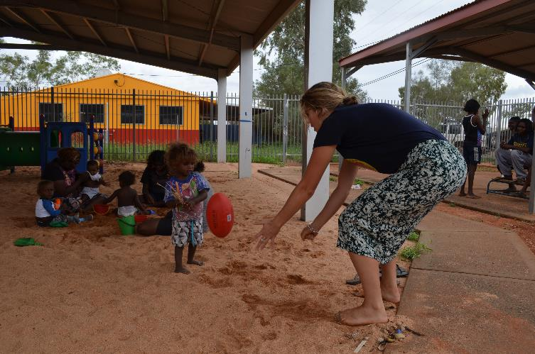
Allow plenty of time to meet with people

Slide 12
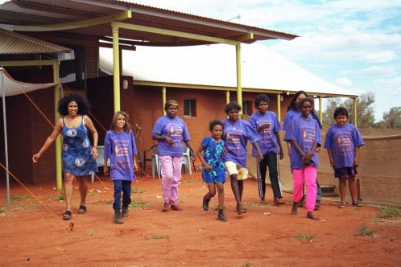
When you arrive
Courtesy call to Shire office, to GEO
Slow down, windows down - walk
Be approachable, say hello
Check your promotion notices, stick more up

Slide 13
Consideration
Remember people are busy and have family commitments, work and voluntary responsibilities, cultural obligations and other MEETINGS.
Introduce yourself clearly, shake hands, remember names.
Explain why you are on the community, seek advice from nominated community members about who to see, what to do.
Seek permission from senior Aboriginal people about where to walk or drive. Don’t make new roads or tracks.
Be respectful when visiting people at their home. Stand at the fence and call out.
Maintain a sense of humour

Slide 14
Meeting with people
Remember and practice your cultural awareness training.
Be slow and steady: don’t rush people to make decisions or to do it your way
Be prepared to talk to everyone, listen carefully
Meet with people where they are comfortable (sitting outside store, in creek bed, on their verandah – meetings don’t have to be in meeting rooms) - privacy
be approachable, allow people to know where to find you and how to contact you
Use properly identified interpreters
Use good plain English

Slide 15
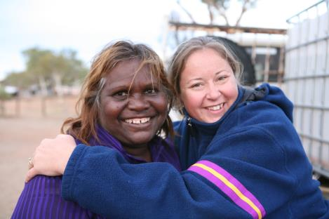
After you leave the community
Follow up on requests
Do what you said you would do
Have people been thanked and/or paid for working with you?
Let people know what you have done
Send back photos and stories

Slide 16
Useful Resources and Readings
Kartiya are like Toyotas
Whitefellas are like traffic lights
Little Red Threat Book
Working Well Guide
NITV
Mpwentwe Country
www.waru.org
Red Kangaroo Books
CAAMA Shop
Walpiri Women’s Voices
TRADITIONAL HEALERS OF CENTRAL AUSTRALIA: NGANGKARI
Tjanpi Desert Weavers

