Slide 1
Early Years Services Central Australia
Jan Fleming
Communities for Children Manager
Anglicare NT
Funded by the Australian Government Department of Social Services

Slide 2
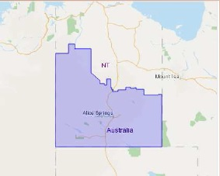
Alice Springs – ABS Data
Central Australia National
Aboriginal 36.2% 2.5%
0-4yo 8.1% 6.6%
Preschool Attendance 4.1% 5.1%
Median weekly income $1513 $1234
<$600p/w income 16%
Notes:
Hi level of low socio economic families
Many of them Aboriginal Australians
There is a large number of young children as compared to the national average yet a lower percentage of this age group attends Preschool
Higher number of young children due to the higher level of young Aboriginal parents
Communities for children is work with communities and the children and families who are experiencing disadvantage and vulnerability.

Slide 3
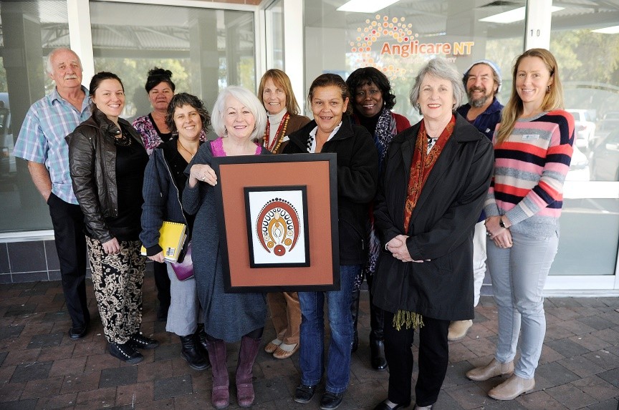
Children’s Programs in Central Australia
Communities for Children Alice Springs
Facilitating Partner
Anglicare NT
Community Partners
Akeyulerre: Ingkenteme Arrernte Cultural Education Program
FAST NT: Baby FAST & Kids FAST
Holyoake: Sandplay Therapy for Children
Lutheran Community Care: Kwatja Etatha – Parents and Families Learning Together & Circle of Security
MCSCA: Susu Mamas Playgroup
Relationships Australia: Holding Children Together
Notes:
Objectives / Outcomes for Anglicare operates the Communities for Children program in Central Australia. We broker funding from DSS to
Strong & Healthy Young local services to provide strong local support to children and families to provide strong local outcomes and build Families local capacity
Early Learning
School Transition & Engagement
Creating Strong Child-friendly Communities

Slide 4
Children’s Programs in Central Australia
Stronger Communities for Children Remote Central Australia
Evidence and Experts
10 sites in NT
Community Ownership
Notes:
Other Communities and Families programs include the SCFC and the Intensive Family Services. SCfC 10 sites in the NT and 4 sites in Central Australia: the newer two since 2015 in Utopia through CAYLUS (Central Australian Youth Link Up Service) as the Facilitating Partner, Atitjere, Engawala and Bonya (Plenty Highway) through Jesuit Social Services as the Facilitating Partner, and the older two since 2013 in Ntaria (Hermannsberg) with Tjuwanpa as Facilitating Partner, and Ltyentye Apurte (Santa Teresa) with AAAC (Atyenhenge-Atherre Aboriginal Corporation) as Facilitating Partners and JSS supporting.

Slide 5
Useful Resources
Available at http://www.anglicare-nt.org.au/service/communities-for-children/
If you have any additions or changes, please let us know on 8951 8002
Notes:
As we won’t be able to get through all of the Community Services Directory what I really want you to take away from this presentation is the knowledge of where you can learn more about Children’s Services: The Alice Springs Community Services Directory covers a broad range of services available in town from addiction to financial, housing to health, mental health and youth services, as well as children’s services, including the contact details for playgroups, childcare centres, schools and more.
The Parenting Services spreadsheet outlines all parenting support services, from parenting programs to support services to assist in the transition through separation and
CfC has also produced the Weekly Planner for Parents in Alice Springs, which is specifically targeted at parents with young ones who are looking for something to do.
These documents are available online. So please access them via Anglicare NT CfC webpage. They are updated as often as we are informed of any changes, so please do let us know if something changes with your organisation, or if you notice anything that is outdated in these documents, and we will make the changes and update the documents online.

Slide 6
Children’s Services Networks
Strong Kids Strong Centre –
Central Australian Collective Impact initiative
Connected Beginnings
Communities for Children Committee
For more information look on the Anglicare Website:
http://www.anglicare-nt.org.au/service/communities-for-children/
Contact Jan Fleming
jfleming@anglicare-nt.org.au or 8951 8002 / 0419 546 446
Notes:
Other networks do come and go, including the Parenting Network and TF-NGO Partnership Group.

